Slide 1
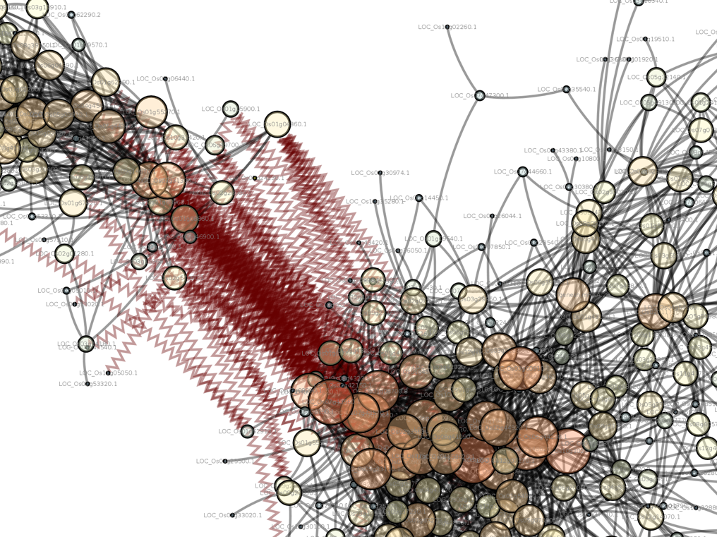
Introduction to Computing for Data Science
Day 16
02/27/2018
Hort 503-01 Spring 2018

Slide 2
Question and Answer Session
Now is the time to ask any questions you may have had concerning the first lesson and assignment.

Slide 3
Class Exercise: Overview
The data for this exercise comes from here:
https://www.ers.usda.gov/data-products/adoption-of-genetically-engineered-crops-in-the-us.aspx
There are two files, one is the data in a spreadsheet, the other is a very “tidy” CSV file.
You will be provided, on Slack, 3 CSV files from data taken directly from the spreadsheet:
corn.csv
cotton.csv
soybean.csv

Slide 4
Class Exercise: Data Explanation
There are four categories of Genetically Engineered Crops:
Insect-resistant (Bt) only
Herbicide tolerant only
Stacked gene varieties
All GE varieties
Notice that each of these categories has its own placement in the file.
You will have to use your knowledge of Python and Pandas to clean up this data. Unlike other data you have read into Python you won’t have nice column header names. You have to fix it.
Rule: don’t use Excel to save new version of the file. Use the files given and your knowledge of Python!

Slide 5
Class Exercise: Task #1
Convert the data into tidy format.
Use only one the file corn.csv
Tidy-fy the two varieties
‘Insect-resistant (Bt) only’
‘Herbicide-tolerant only’.
Combine both varieties into one data frame containing these columns:
State: The state where the measurement was made
Crop: The type of crop: Corn, Cotton, Soybean
Crop Title: Containing one of these values
Genetically engineered (GE) corn
Genetically engineered (GE) upland cotton
Genetically engineered (GE) soybeans
Variety: The “category” for the variety
Year: The year the observation was made
Unit: The type of value. Should be one of:
Percent of all corn planted
Percent of upland cotton planted
Percent of all soybeans planted
Value: The percentage

Slide 6
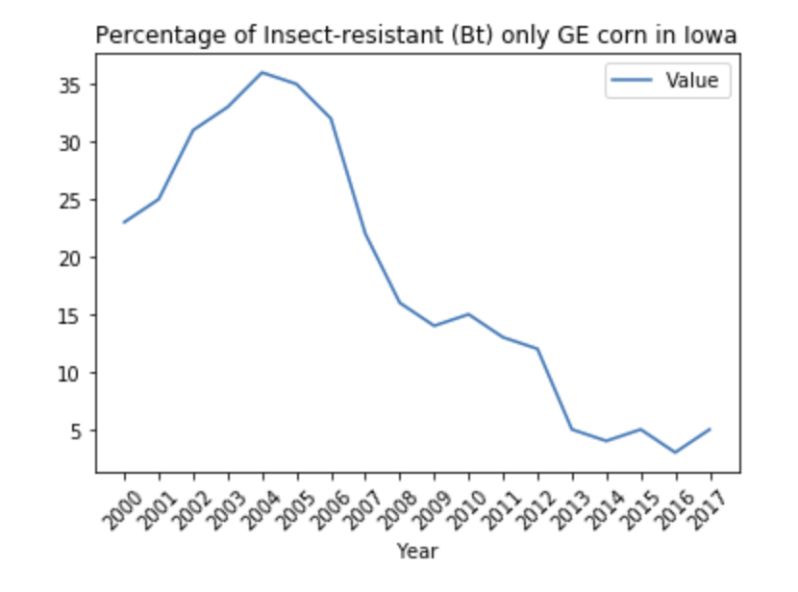
Class Exercise: Task #2
Generate a line plot showing the change in percentage in Iowa for the Insect-resistant (Bt) only variety.

Slide 7
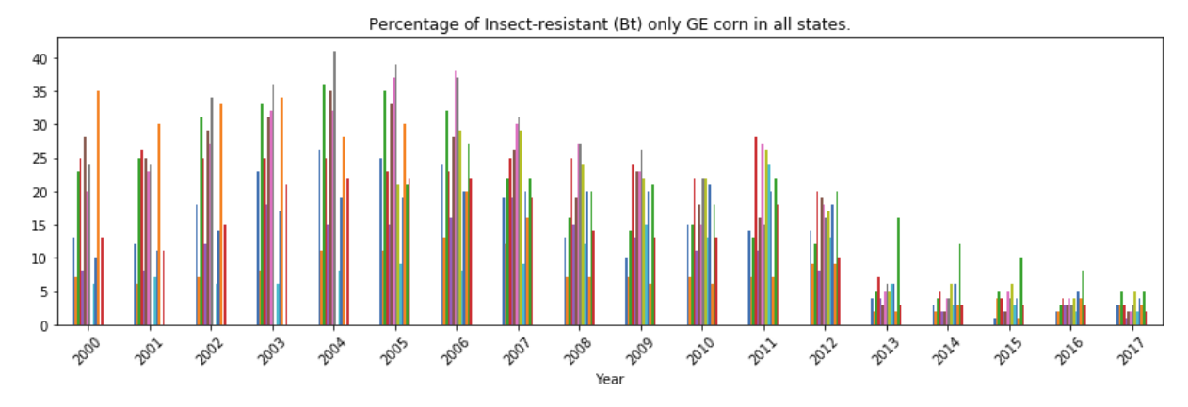
Class Exercise: Task #2
Generate a bar chart showing the percentages of the Insect-resistant (Bt) only variety for all states:
Hint: you will need to use the pivot function to reorganize your data for drawing the boxplot above. Use these two pages of documentation:
https://pandas.pydata.org/pandas-docs/stable/visualization.html
https://pandas.pydata.org/pandas-docs/stable/generated/pandas.DataFrame.pivot.html

